Slide 1
Building Products Better
An Agile Informational
Lawrence Artl
CS-250-21EW1
Final Project
October 14, 2021

Slide 2
What is “Agile”?
Agile is an approach to software development that focuses on small, incremental deliveries rather than one large “big-bang” launch. The Agile approach is designed to help teams deliver to their customers faster and with fewer issues along the way (and after the fact). Agile plans and requirements are constantly evaluated with feedback given regularly so that the team can quickly respond to necessary changes during development of the product.
Agile teams typically consist of three main “players”...

Slide 3
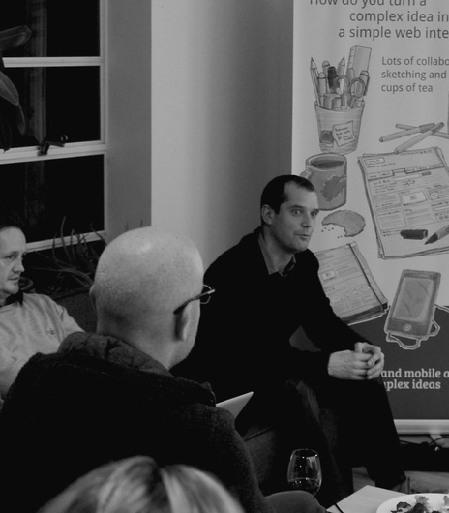
The Product Owner
Develops/Maintains the product vision
Manages the product and product backlog
Involves the stakeholders/end-users in backlog refinement/management
Aligns with other product owners from the product, company, or customer perspective

Slide 4
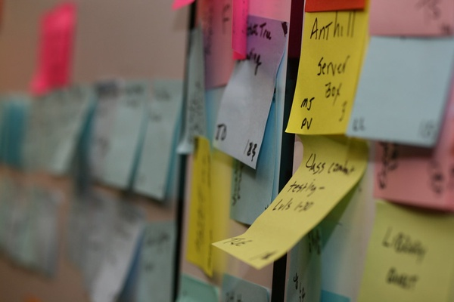
The Scrum Master
Focuses on team needs; provides boundaries where the team can collaborate
Coaches team members; deals with bad attitudes and behaviors that impede the team
Transfers Agile knowledge to the team
Manages impediments
Eliminates waste
Manages team health and culture

Slide 5
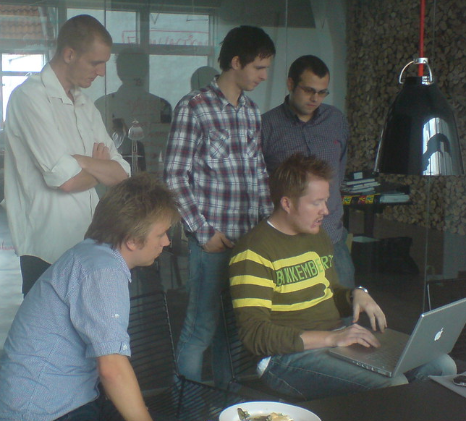
The Development Team
Acts as a self-organizing unit
All team members are at the same ‘level’, no special titles, no ‘sub-teams’
Cross-functional, have all the skills necessary to develop the product
Committed to achieving the common sprint goal

Slide 6
How is Agile Structured?
The Agile approach to the Software Development Life Cycle consists of phases of development that run on a continuous loop. This loop is repeated for each phase of the product development. Where a typical SDLC starts with a plan and fully ends once all features have been developed and the product is ready to be delivered, Agile considers each individual feature for its own cycle of development.
Features are broken into user “stories” that are developed during iterations known as “sprints”. Each sprint consists of a circular path of phases that can be repeated as necessary until that particular feature or set of features is completed.

Slide 7

The Phases of the SDLC in Agile
Develop
Test
Deploy
Maintain
Planning
Define
Each phase of the Agile process is clearly defined and serves a purpose. The phases follow one another in a loop, and the loop can be repeated with new user stories as often as necessary in order to complete a project.
Design
The product is developed by the team; the product backlog acts as a guide for what is prioritized. Feedback can be given throughout this phase, and refinements can be made on-the-fly.
The developed product is tested for useability and accuracy; testers give feedback and product refinements can be adjusted as necessary
The final product is deployed to the desired market for user interaction; system testing and user acceptance testing is done here.
Developers make changes and refinements as users, markets, security, and etc changes. Production testing is ongoing, as well as bug checks.
In the planning phase, a project is envisioned, and key features are prioritized; platform for deployment, architecture, basic UI are planned here as well
Key aspects of the product are defined based on market research, user feedback, and stakeholder requests; a product backlog is created by the product owner
The final product is designed based on the features defined in the previous phase; test plans are developed here as well

Slide 8
Is Agile a better approach to the SDLC?
Agile is a very complex and involved approach to software development. It cannot be implemented overnight, but must be slowly transitioned to over time. Agile can net better results and higher productivity when used properly, but the team must be bought into it for this approach to be successful.
Agile is not always going to be the best approach for every team. There are some things to consider before adopting an Agile approach to developing a product before production begins.

Slide 9
Agile versus Waterfall
Waterfall
Linear approach
Limited feedback
Changes require extra planning
Agile
Circular approach
Regular feedback
Easy to add/make changes
Considering a waterfall approach, the linear nature of this method requires the majority of development be completed before any feedback is given. Changes to the product at this stage will mean more planning and redesign. In an Agile approach, features are developed by priority, and feedback is given incrementally throughout development. This allows the team to pivot quickly when changes need to be made, regardless of how large those changes may be. Where in a waterfall approach the entire product is given one cycle, the same product is broken into “stories” of features, each given its own cycle of the process. A waterfall is a long marathon, while Agile is a series of quick sprints.

Slide 10
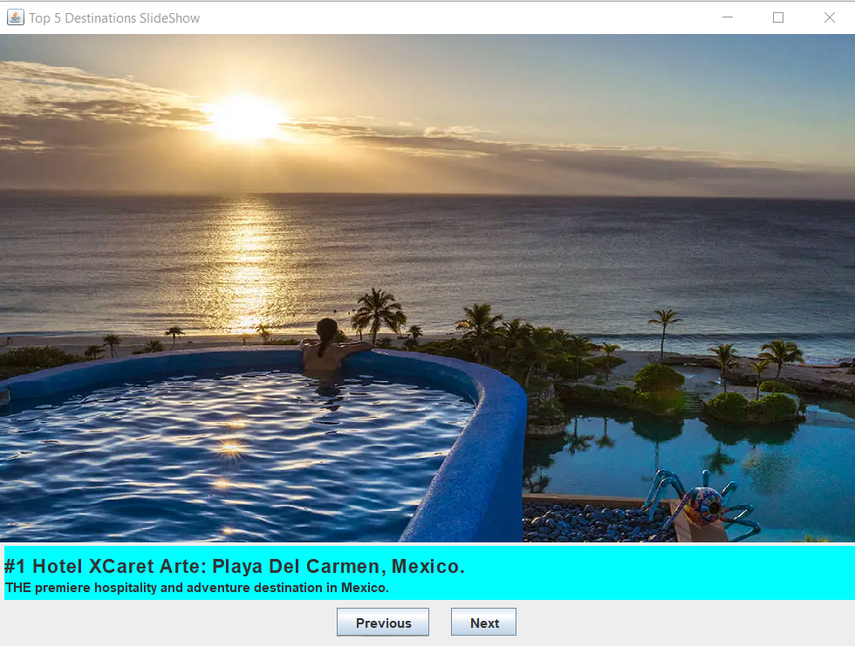
Agile versus Waterfall
Example
During our recent sprint, the product owner conducted a focus group with potential users, finding that a new approach to the partially developed product was necessary. Because of regular feedback and communication within the entire Scrum team, developers were able to quickly implement these new features into the product without losing any time in production.

Slide 11
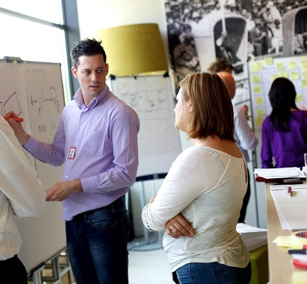
Which Approach is Right for Your Product?
Consider asking:
How long will it take to develop my product?
How quickly does the product owner need the product?
How many features will be included in the product?
How likely are product features to change mid-development?

Slide 12
Which Approach is Right for Your Product?
Waterfall Approach
Relatively short time frame for delivery/development
Short feature list
Unlikely to change direction mid-project
Agile Approach
Longer delivery time frame or more involved development
Long features list
Changing product features is likely
It is also important to consider your team when deciding between the two approaches. Agile requires a large amount of communication between team members, and a development team that is more self-sufficient. While the Agile approach may be a more modern way to develop products, the waterfall method is still useful in many situations and within certain team structures.

Slide 13
References
Overeem, B. (2016, July). Characteristics of a great scrum team. Scrum.org. https://www.scrum.org/resources/characteristics-great-scrum-team-0.
Charter the team : Full scale agile™. Full Scale agile™ : Radical Agile. (2021, July 9). https://fullscaleagile.com/charter-the-team/#_Toc72418174.
Georgieff, M. (n.d.). Building your first agile team charter. Agile Marketing Guidance for Orgs, Teams, and Individuals. https://www.agilesherpas.com/blog/agile-team-charter.
Tutorials Point. (n.d.). SDLC - Agile Model. Retrieved October 14, 2021, from https://www.tutorialspoint.com/sdlc/sdlc_agile_model.html
All photos originated from Creative Commons, https://creativecommons.org/

